Slide 1
Using a Self-Organizing Map to Understand MNIST CNN Errors
CAPSTONE 2026 · GROUP 5
Fyrooz Khan, Nazish Atta · Supervised by Dr. Amir Jafari · Preliminary Presentation · [Date]
Notes:
Welcome everyone. Today covers the project from the start through the error-pattern analysis. Fill in the date and presenter names.

Slide 2
Where does the CNN go wrong, and can a map of its embeddings show us why?
RESEARCH QUESTION
Notes:
State the question in plain words. Then say that the SOM gives a 2D map where similar images sit close together, so groups of mistakes become visible.

Slide 3
Four phases, two completed so far
ROADMAP
Done
Done
Next
Next
Phase 1
Phase 2
Phase 3
Phase 4
Baseline CNN on MNIST
SOM training, cluster analysis, error patterns
Novelty detection
Guided retraining
Today we cover Phases 1 and 2: from the baseline CNN through the error-pattern analysis.
Notes:
Use this slide to show the audience where today’s results sit in the full project. Phase names follow the professor’s proposal.

Slide 4



CNN alone against the SOM-assisted CNN
END-TO-END PROCESS
Path 1 · CNN only
Sample
(NumPy)
CNN
Prediction
CF1
Compare CF1 with CF2
Path 2 · SOM-assisted CNN
Sample
(NumPy)
SOM /
graph
Retrain
CNN
Prediction
CF2
Both paths run on the same test images. CF1 is the CNN-only confusion matrix, the same one as in Phase 1. CF2 is the confusion matrix after the SOM / graph stage. [TBD: one line on what the SOM / graph stage does to each sample.]
Notes:
This is the main idea of the project, taken from the hand-drawn sketch. Path 1 sends each sample straight through the CNN. Path 2 sends it through the SOM / graph stage and retraining first. Comparing the two confusion matrices, CF1 and CF2, shows what the SOM stage changes. Results come after Phases 3 and 4.

Slide 5
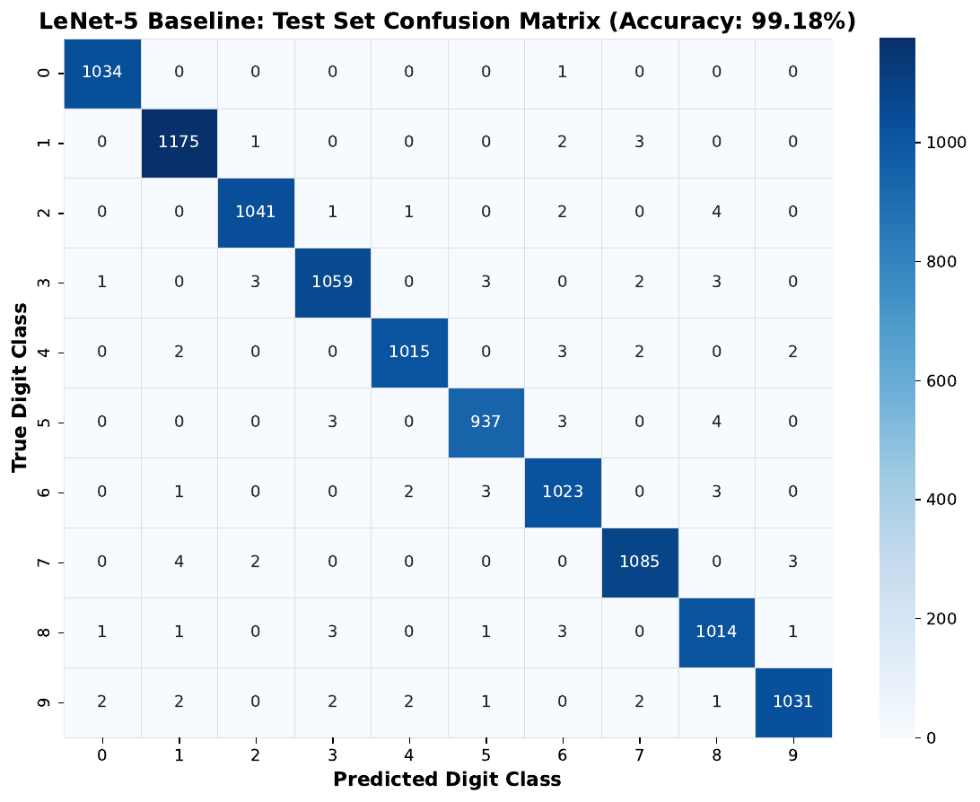
LeNet-5 reaches 99.18% test accuracy
PHASE 1 · BASELINE CNN
Measure | Value
Test accuracy | 99.18%
95% Wilson interval | 98.99–99.34%
Macro F1-score | 0.9918
Test mistakes | 86 of 10,500
Validation mistakes | 92 of 10,500
Training mistakes | 29 of 49,000
MNIST split once, stratified: 49,000 train, 10,500 validation, 10,500 test. LeNet-5 trained for 20 epochs with Adam; the best validation checkpoint is kept, and its 84-number fc2 layer gives the embeddings.
Notes:
Phase 1 of the proposal: the baseline CNN and its benchmarks. The test set was used once, to score this baseline. The confusion matrix on the right is the one for the test images.

Slide 6
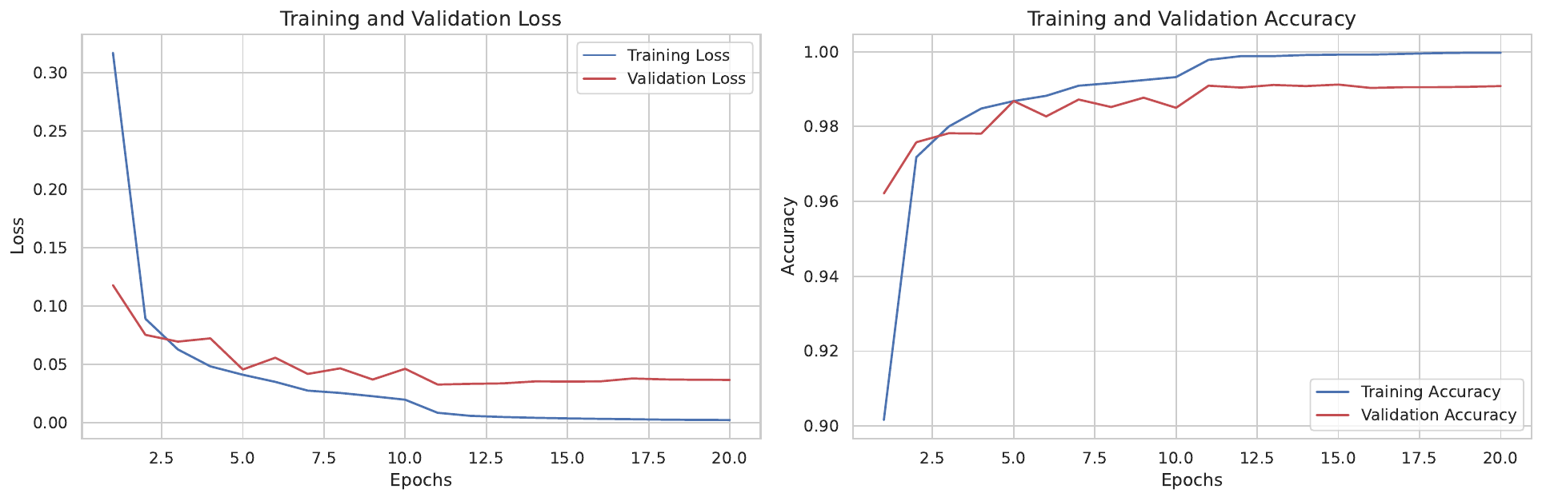
Training converges and validation accuracy levels off
PHASE 1 · TRAINING
Loss and accuracy over 20 epochs. Training accuracy reaches 99.97%, while validation accuracy levels off near 99.1%. The best validation accuracy, 99.12% at epoch 15, gives the checkpoint used for everything after.
Notes:
Training accuracy keeps rising slightly while validation accuracy flattens. That is why the checkpoint is picked by validation accuracy.

Slide 7
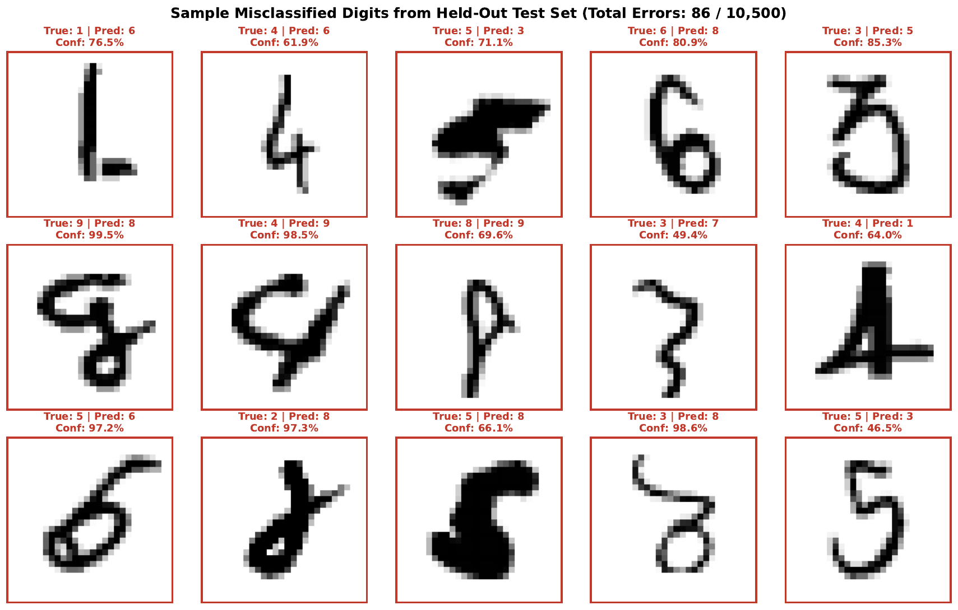
What the baseline CNN gets wrong
PHASE 1 · MISTAKES
Most common confusions
On validation: 5 → 0, 9 → 4 and 4 → 9 (six each), then 9 → 8 and 5 → 3 (five each). The figure shows 15 of the 86 test mistakes.
Confidence
Average 0.997 when right and 0.833 when wrong (validation).
Some are confident
Several wrong answers come with confidence above 97%.
Notes:
The figure shows a sample of the 86 test mistakes with the true label, the prediction and the CNN’s confidence. The confidence numbers in the cards are from the validation split.

Slide 8
Three grid sizes, one chosen for the main analysis
PHASE 2 · SOM TRAINING
Measure | 10×10 | 15×15 (chosen) | 20×20
Quantization error (QE) | 1.21 | 1.06 | 0.98
Cell purity | 97.6% | 98.2% | 98.4%
Topological error (TE1) | 4.8% | 6.6% | 7.7%
Why 15×15
Fair comparison
No grid was clearly better at predicting mistakes. 15×15 has high purity and a lower topological error than 20×20.
Same data, same three starting neighborhood sizes, ten maps per grid, validation data only. Main run: 15×15, initial neighborhood 11, 250 epochs, seed 42, trained on the 49,000 × 84 training embeddings.
Notes:
The SOM is trained on the 84-number embeddings from the CNN’s second-to-last layer. Larger grids fit more closely but have a higher topological error. The error analysis is repeated on the other two grids to check the conclusions do not depend on this choice.

Slide 9
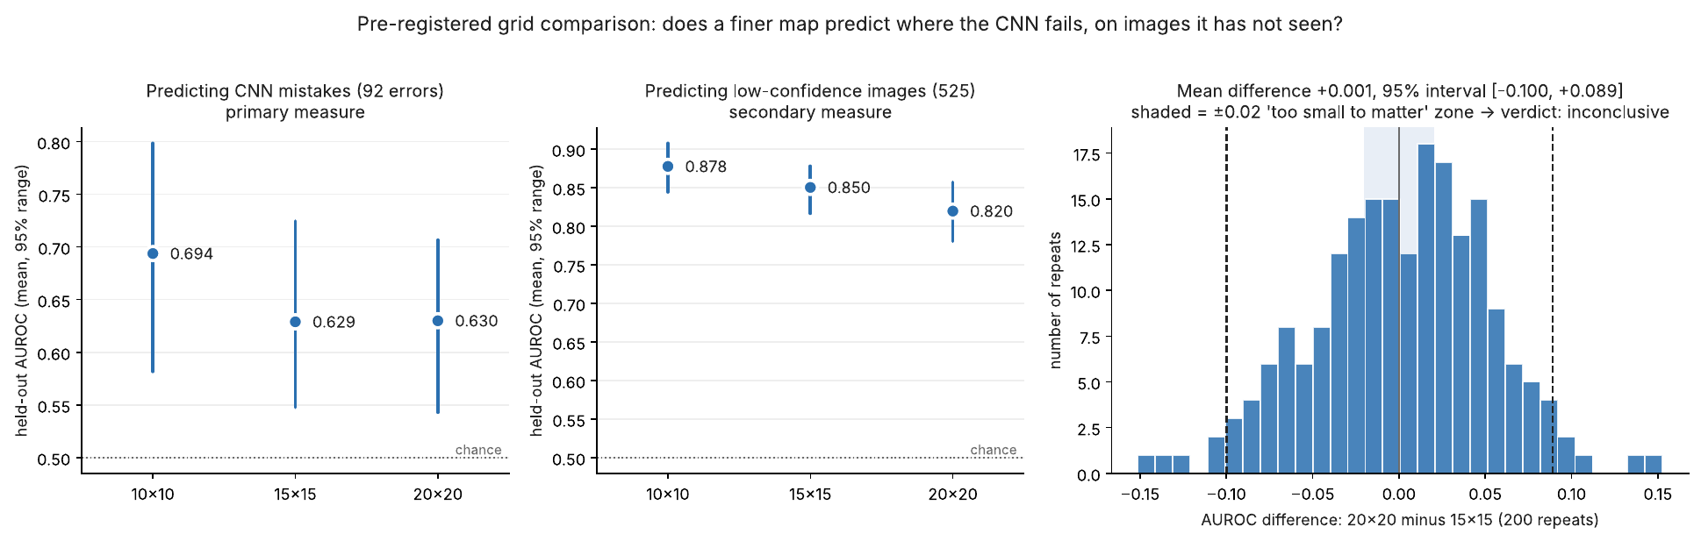
A finer grid does not clearly predict mistakes better
PHASE 2 · GRID COMPARISON
The AUROC difference between 20×20 and 15×15 is +0.001 (95% interval −0.100 to +0.089), so the comparison is inconclusive. With only 92 mistakes, differences below about 0.1 cannot be seen.
Notes:
The grid comparison rule was fixed before looking at the results. The left panel is the primary measure, predicting the 92 CNN mistakes. The right panel shows that the difference between the two larger grids is centered on zero.

Slide 10
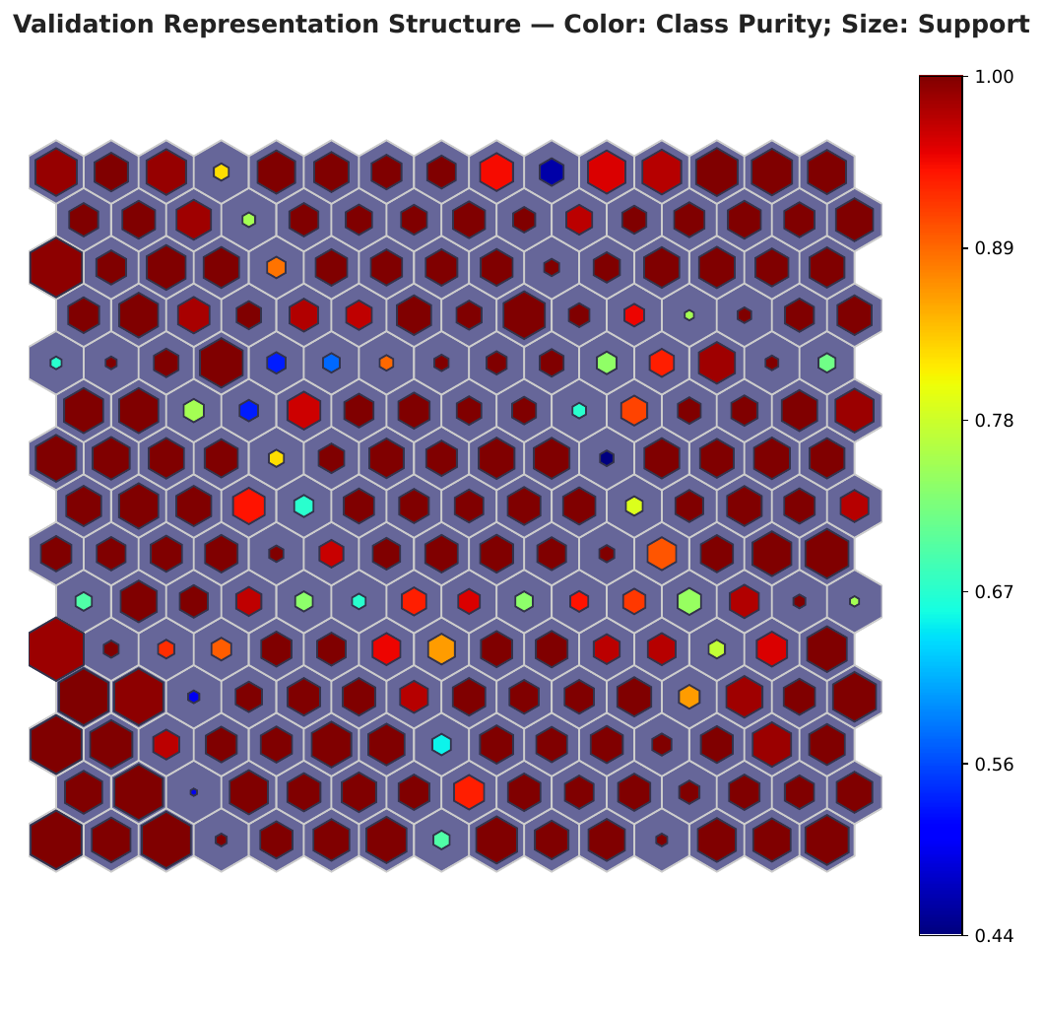
The map’s cells follow the digit classes
PHASE 2 · CLUSTER ANALYSIS
98.19%
Cell purity on validation images
17.4% with shuffled labels (95% range 17.0–17.7%, p = 0.001)
6.18%
Topological error (TE1)
Quantization error 1.041 on validation, 1.039 on training
Color: class purity. Size: images in the cell.
Notes:
Purity is the share of a cell’s images that belong to its most common digit. The chance level comes from shuffling the digit labels 1,000 times.

Slide 11
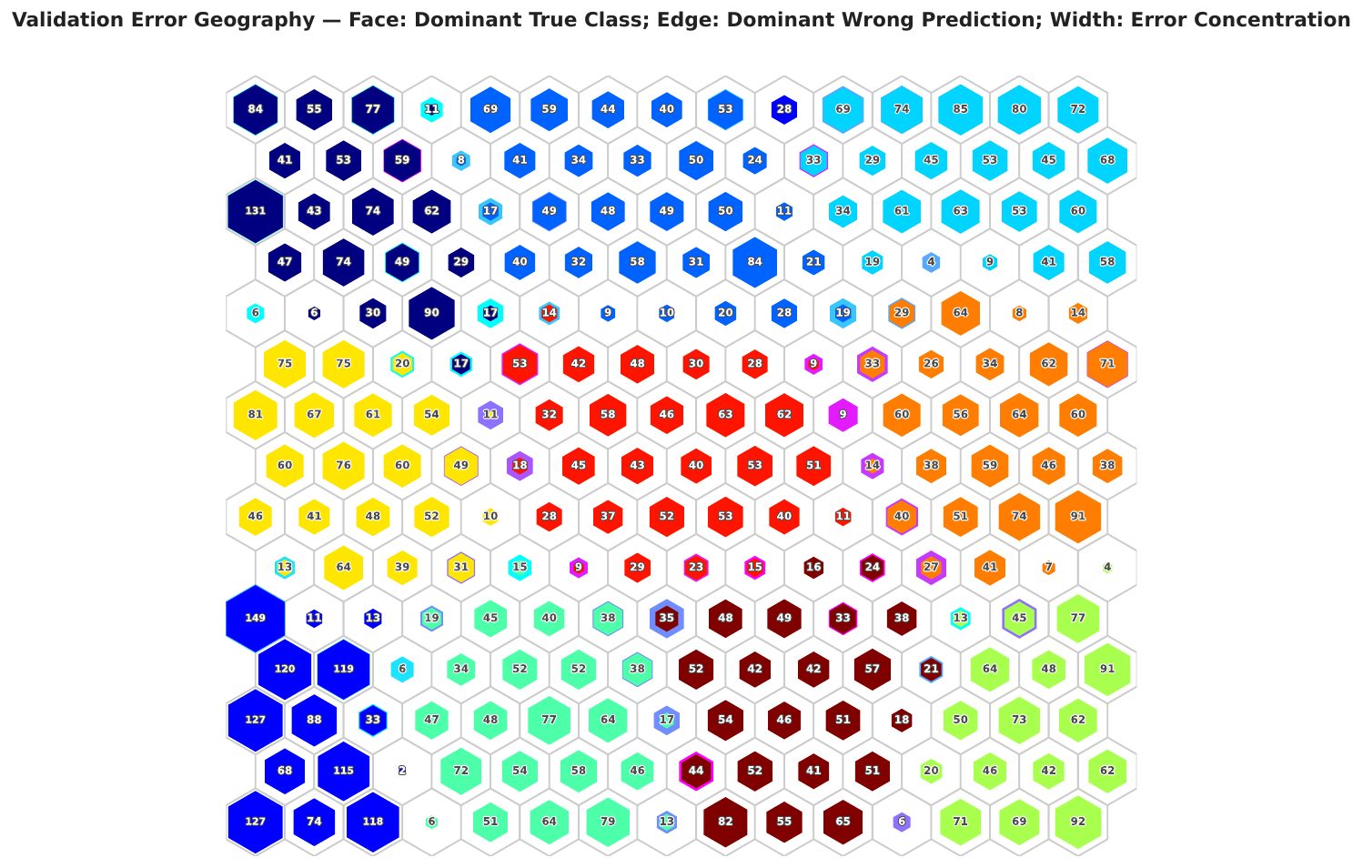
The CNN’s mistakes gather in a few hotspot cells
PHASE 2 · ERROR PATTERN ANALYSIS
11.1×
Concentration ratio
11 hotspot cells hold 11.1 times their fair share of the 92 validation mistakes (95% range 6.1–17.6). Chance is about 1 (p = 0.005).
Fill: most common true digit. Edge: most common wrong answer. Size: how many mistakes.
Notes:
Hotspots are chosen on a random half of the validation images and measured on the other half, repeated over 200 splits, so the ratio is not inflated by picking and measuring on the same data. The ratio is the share of mistakes in hotspots divided by the share of images in hotspots.

Slide 12
The pattern holds on all three grid sizes
PHASE 2 · ROBUSTNESS
Measure (validation) | 10×10 | 15×15 | 20×20
Hotspot cells | 5 | 11 | 20
Concentration ratio (95% range) | 10.5 (5.4–17.3) | 11.1 (6.1–17.6) | 13.4 (8.0–19.3)
Chance level (median) | 0.98 | 0.94 | 0.93
Spearman, error rate vs purity | −0.755 | −0.810 | −0.766
Spearman, error rate vs digit mix | +0.778 | +0.816 | +0.768
92 validation mistakes, all p = 0.005. Cells with purer digits make fewer mistakes, and cells with more mixed digits make more. The robustness check says the pattern holds on both other grids. Do not use the ratios to compare grids with each other.
Notes:
Digit mix means the entropy of the digits in a cell. A negative correlation with purity and a positive one with digit mix say that mistakes sit where digits overlap.

Slide 13
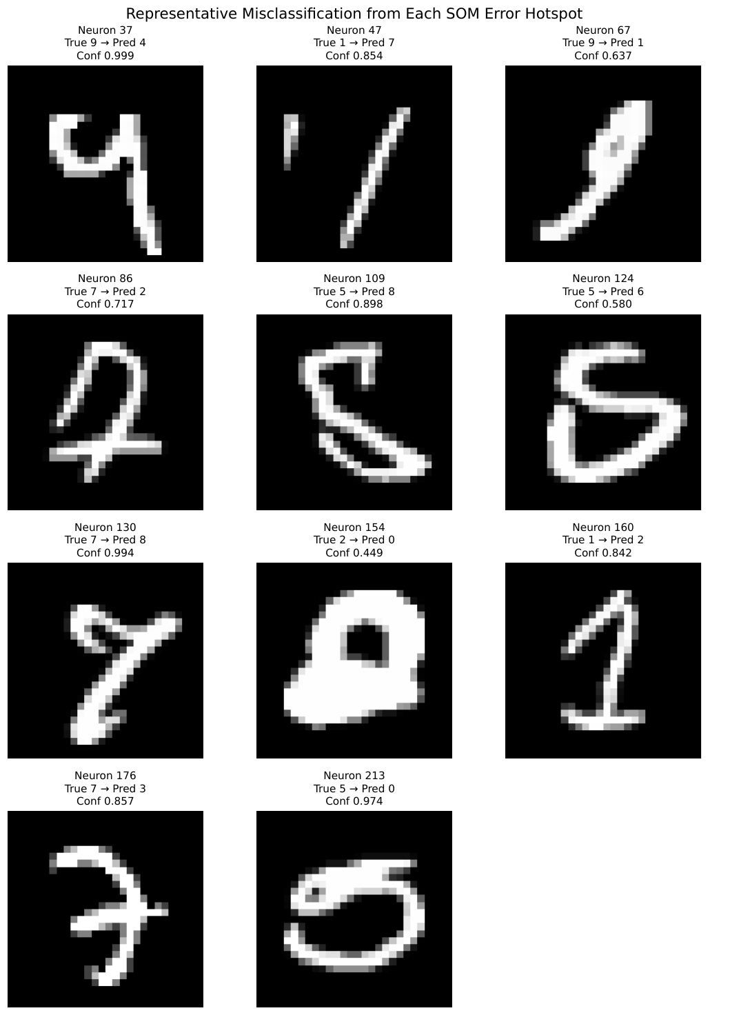
What the hotspot mistakes look like
PHASE 2 · HOTSPOT SAMPLES
One example per hotspot
Each of the 11 hotspot cells shows its most representative mistake, with the true digit, the predicted digit and the CNN’s confidence.
Sure and unsure mistakes
Confidence runs from 0.449 to 0.999, so some hotspot mistakes are confident and some are not.
Why are these hard?
[TBD: your reading of the samples, for example similar shapes, noise or a rare handwriting style.]
Notes:
This is the proposal’s “retrieve and visualize the actual images in error hotspot regions” step. Fill in the last card with your own hypothesis after looking at the images.

Slide 14
The SOM concentrates errors more than k-means
KEY NUMBERS
11.1
5.6
SOM hotspot ratio
k-means hotspot ratio
15×15 grid, 225 cells · 95% range 6.1–17.6 · hotspots hold 1.6% of images
225 clusters, median of 10 seeds (4.6–6.1) · hotspots hold 3.8% of images
Hotspot ratio: the share of mistakes in the 11 hotspot cells divided by the share of images in them. A ratio of 1 means mistakes are spread evenly. Cells are chosen on one half of the validation images and measured on the other.
Notes:
Use this layout for one or two headline numbers. Add the plain-words definition of hotspot ratio in the line above the footer.

Slide 15
Predicting CNN mistakes: AUROC by method
PHASE 2 · BASELINE COMPARISON
SOM cell
0.685 (0.624–0.738)
k-means cell
0.693 (0.651–0.729)
kNN impurity
0.874 (0.829–0.917)
Max-softmax
0.981 (0.974–0.987)
Reading: the SOM’s value is the interpretable map, not better error detection.
Average precision: SOM 0.053, k-means 0.034, kNN 0.228, max-softmax 0.336. Same 92 validation mistakes, 15×15 grid, 95% ranges in brackets. Bar length is proportional to AUROC.
Notes:
Be upfront: simple confidence (max-softmax) predicts mistakes better than the SOM. The SOM earns its place by showing where and how the errors group. Ranges come from repeated half-splits for the cell scores and from bootstrap resampling for kNN impurity and max-softmax.

Slide 16
Novelty detection
PHASE 3
[Results go here once Phase 3 is complete]
Planned: SOM quantization error and U-matrix distance against max-softmax, energy and Mahalanobis, scored by AUROC
Notes:
Empty on purpose. Fill in after Phase 3.

Slide 17
Guided retraining
PHASE 4
[Results go here once Phase 4 is complete]
Planned: SOM-guided selection of hard examples against random selection, with the same budget and seeds
Notes:
Empty on purpose. Fill in after Phase 4.

Slide 18


CF1 against CF2 on the same test images
END-TO-END COMPARISON · RESULTS
CF1 · sample → CNN → prediction
CF2 · sample → SOM / graph → CNN → prediction
[CF2 confusion matrix]
CF1 is the baseline CNN’s test confusion matrix from Phase 1. [TBD: one sentence on how the predictions change in CF2.]
Notes:
CF2 stays empty until the SOM / graph stage and retraining have been run. Both matrices must use the same test images and the same labels.

Slide 19
What these results can and cannot tell us
LIMITS AND LEAKAGE CONTROL
Tuned on validation only
One grid analysed
Hotspot analysis uses the validation split. The test set stays untouched until the protocol is fixed.
Only the 15×15 SOM was analysed in this check. The grid comparison could not separate the three sizes, so 15×15 was chosen as a middle option.
Few errors
Shared validation data
There are only 92 validation mistakes, so the intervals are wide. MNIST is also easy, so Fashion-MNIST and CIFAR-10 are needed before general claims.
Validation was also used to pick the CNN checkpoint, which can make validation results look a little better than they would on new data.
Notes:
These are the caveats already written in the report. Saying them yourself first makes the results more credible.

